Slide 1
What questions should we ask of social policy?
Dr Ben Spies-Butcher
Macquarie University

Slide 2
Three questions
Is productivity the right question?
How do we reconcile putting consumers first and taking citizens seriously?
What would it mean to use economic analysis to ask social questions?

Slide 3
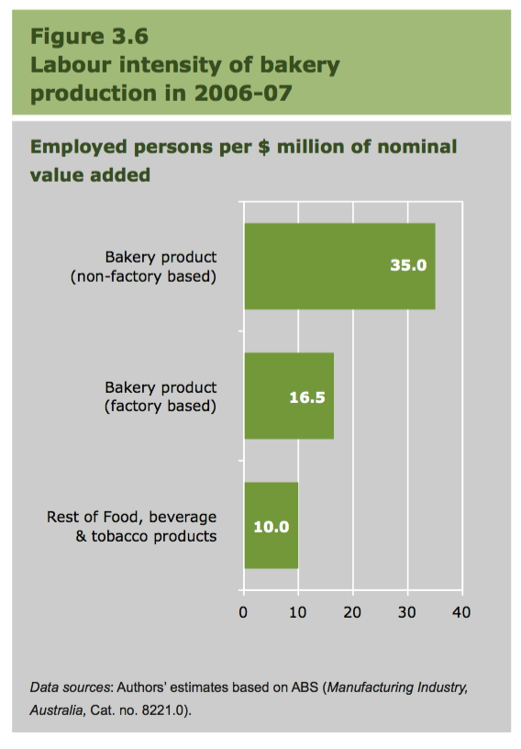
Quality and Productivity
A key challenge for assessing productivity is identifying changes in quality
Recent changes in manufacturing towards artisan forms have highlighted this challenge
Many of these changes are to be welcomed, yet they confound traditional productivity measures
The problems are much more acute in service provision
Source: Productivity Commission Update, April 2014, p.38.
Notes:
See Peter Ferguson 2016, ‘The politics of productivity in Australia’ and John Quiggin on the record of productivity in Australia.

Slide 4
Who is sovereign?
Who gets to choose what ‘qualities’ are important and how they are judged?
In social services, where governments fund provision and set rules, surely we need more politics not less
What are the limits to consumer and citizen choice and rationality?
How do we inform citizens and consumer to make decisions, and what are we informing them about?
Source: Productivity Commission 2012, Schools Workforce, p.19.
Teachers Federation response to Grattan Institute Report on impact of class sizes, 2010.

Slide 5
Designing policy research to inform political debate
Answering social questions
Informing public debate
Creating space for ‘social questions’ to be asked
Informing social decisions with economic data
From Arbitration to Fair Work
Problems in leaving social questions to judges
Inquiries and expert panels can inform public debates and campaigns
Notes:
“It is to be regretted that the Legislature has not given a definition of the words. It is the function of the Legislature, not of the Judiciary, to deal with social and economic problems; it is for the Judiciary to apply, and, when necessary, interpret the enactments of the Legislature.”

