Slide 1
Monsters only live in the dark:
Elements of a healthy policy ecosystem
Power to Persuade
15 August 2016
Brendan Lyon
Chief Executive Officer

Slide 2

Consensus about first principles/outcomes needed

Slide 3

Consensus about first principles/outcomes needed
2. Robust data to diagnose gaps or failures

Slide 4
Consensus about first principles/outcomes needed
2. Robust data to diagnose gaps or failures
3. A ‘battle’ between alternative solutions from stakeholders

Slide 5
4. Finding enlightenment among the array of self-interest

Slide 6
4. Finding enlightenment among the array of self-interest
5. Should be bureaucratic and stakeholder interest - champions to explain to the community

Slide 7
4. Finding enlightenment among the array of self-interest
5. Should be bureaucratic and stakeholder interest - champions to explain to the community
6. There must be political will driving change, or it will not happen (even if the first five traits are satisfied)

Slide 8
If you cannot agree on where you’re going, you’re never going to agree on how to get there
1. Consensus about first principles
Notes:
Build consensus around what we want or need, as a community.
Thought prompt: Is public health about owning buildings and managing staff, or keeping the community well?
Thought prompt: “The problem with the IPA model is it does nothing for superannuation….” Unnamed member, NSW Housing Ministerial Advisory Committee.

Slide 9
With agreement about first principles, a healthy policy ecosystem needs good information, about real performance
2. Robust data to diagnose
gaps/failures
Notes:
If we measure it, we can see the specific gaps.
Evidences non-discretionary change (terminal decline).
And we can measure our successes in fixing it.
Respected evidence key to winning political and community focus on need for change.
Thought prompt: Road transport only measures inputs – so we don’t know much about what’s needed, or where.
Thought prompt: Electricity reform in NSW was easier, because the evidence was so clear that prices would be lower, if private.

Slide 10
No one has a monopoly on good ideas, so it’s healthy to see competing options put forward
3. A ‘battle’ of competing ideas
Notes:
Need to harness expertise of the ‘self interested’ –competitors, political, community and policy stakeholders, NFP sector etc.
Thought prompt: Social housing.
A ‘forgotten end’ of social policy, now sees a ‘battle’ of competing ideas to fix social housing (eg IPA, NSW Fed of Housing Assoc/MAC, Social Ventures Australia, property developers etc)

Slide 11
Of course, the battle of ideas relies on government sector being able to transparently assess public value, amidst private benefits
4. Finding enlightenment, among the array of self interest
Notes:
Within our healthy policy ecosystem, there will be a range of solutions offered by diverse stakeholders
Government needs the skill to assess transparently what will work best to meet the ‘first principles’ (point one) – at best value for money.
Thought prompt: NSW Treasury’s Commissioning and Contestability Unit.

Slide 12
With agreed outcomes, identified gaps, competed solutions and transparent public assessment, everyone should welcome change
5. Ideally, bureaucracy, community and stakeholders will be supportive
Notes:
First four steps should see government, community and stakeholders understand the reason for change – and change model.
Ideally, line agency management and central agencies supportive.
Winning (and keeping) community is important.
Thought prompt: Poles and Wires NSW

Slide 13
Political will is the only defining trait. Without political will, the best policies in the world won’t happen
6. But political will is fundamental
Notes:
The literature shows that political will is hard to define – and even harder to measure.
But it is very obvious, when it is absent.
Thought prompt: The CPRS saw traits one through five, but it died when political will evaporated.

Slide 14


Slide 15

Try to have fun: NSW electricity.

Slide 16
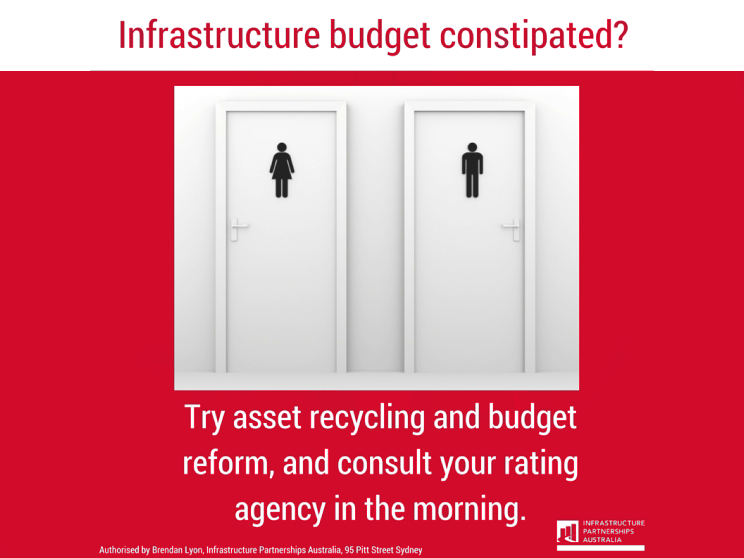

Slide 17


Slide 18
Thank you!

