Slide 1
Connected policy /service ecologies – impact of integration terms
Robyn Keast Southern Cross University
Power To Persuade Symposium 15 August 2016
(Michael Charles & Gemma Carey)

Slide 2
Background
Search for integration intensified – not only work across boundaries but socio-ecological levels
Collaboration is king! But …
Growing array of terms used to describe /implement this direction
Some are home-grown from public/non-for-profit sector
Some ‘borrowed’ co-opted from other sectors/industries - fads
IORs & IOEs –same or different – and does it matter?
Examine the terms to answer this question, highlight effects & considerations

Slide 3
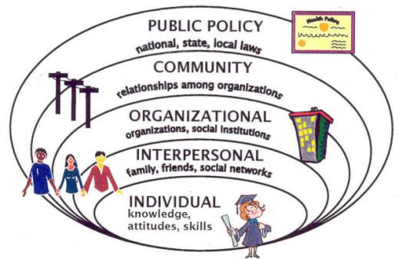
Integrating Socio-political Systems

Slide 4
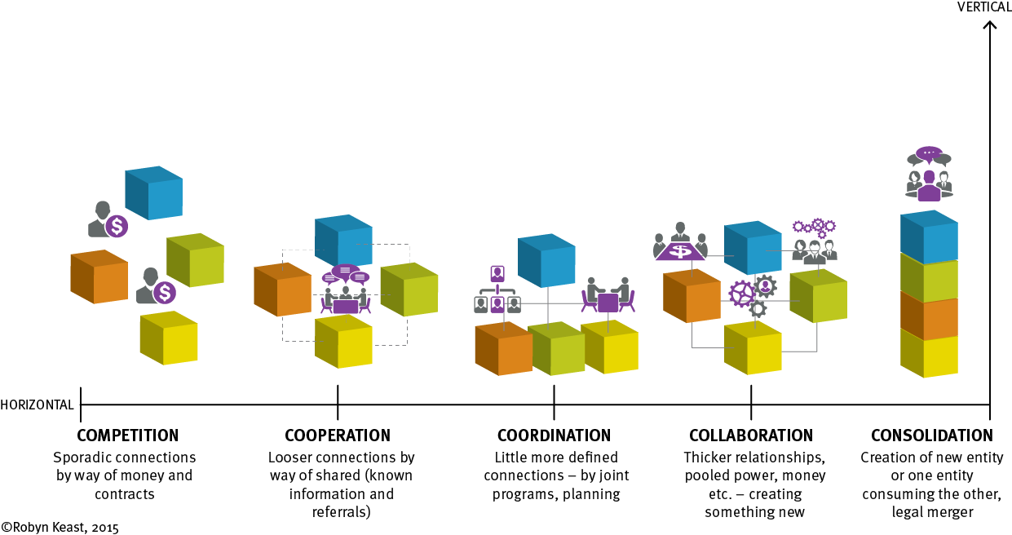
Inter-organisational relations – 5Cs

Slide 5
Inter-organisational entities (ioes)
Defined as: the manifestations of the existence of Inter‐organizational relationships – i.e. the entity.
Alliances, partnerships, networks, joint ventures, consortiums, coalitions, partnerships and compacts ….
New (?) terms - co-design and co-production, co-leaning (either between government and organisational entities, or government and citizens).
Others ????

Slide 6
Examining the terms … 1
Term | Purpose/focus | Defining features
Amalgamation/merger | Formed to achieve efficiency | Vertical coordination via hierarchical /formalised authority
Alliance | Joining of resources/forces to meet a common purpose (protection, trade) | Limited number of partners (exclusive) Close relations by affinity, similar or shared interests (strong lock-in) Pooling of resources Incomplete contracts, detailed negotiations & communication
Joint Venture | Legal association for the purpose of mutual profit | Entity owned by two or more independent entities Vary in terms of legal basis Can be a product of alliance
Network | Aggregate grouping (three or more) of entities around a common function or task | Based on flow of resources & affect & cohesion of effort Open system of interpersonal relationship Self-organising (loose lock-in) Inclusive membership

Slide 7
And more … 2
Consortium | Loose association for the purpose of engaging in a joint venture, work together to achieve chosen objective | Interagency agreements, such as MOUs incomplete contractual agreements members responsible to others in terms of agreed actions Pooling of resources
Coalition | Temporary alliance formed for the purpose of defence against attack, advocacy/gain access/support | Inter-agency agreements such as MOUs Clear rules and operating principles Temporary or time limited arrangement
Partnership | a. formal, legal association for the purpose of shared profit/loss b. informal connecting relationship | Unincorporated Smaller number of partners Linked by written (formal) or verbal (informal) agreements Incomplete contracts Time limited by agreement

Slide 8
Same or different? and does it matter?
Similarities, but also subtle and not so subtle differences between these terms,
all of which are likely to impact on performances and expectations
Used interchangeably – misses the intricacies and dynamics of integration.
Wrong type of relationship or arrangement for purpose sought
Failed projects, sub-optimal outcomes, disconnection /dis-harmony due to different expectations
Potential to draw organisations into seemingly neutral or equal relationships that may in fact be anything but .
Research implications for continued, undifferentiated use of the terms as broad metaphors for working together.
particularly - purpose and legal requirements,
Together can erode the relationships, capacity & focus of system

Slide 9
… well yes! … Cacophony

Slide 10
Ways forward???
Ideally, a precise decision regarding the type of relationship (IOR) and associated arrangement (IOE) for the outcomes sought would form part of the starting point for the proposed joined-up work,
Collaboration decision support Tool
Taylor (2000) proposes, the formation of a new, agreed language.
But … often terms are already in place /embedded in practice/ or imposed it is highly likely that the opportunity to clearly define the terms has long passed.
Again, time /effort invested in establishing a shared understanding of terms and agreement on how they will be operationalised within projects.
At least orchestrate a constructive rather than chaotic cacophony!

