Slide 1
Power to Persuade A practitioner's perspective on complex policy ecosystems
Christine Flynn
Organisational Consultant
15 August 2016

Slide 2
Context: complex policy ecosystems
Increased use of community and governance forums with mixed groups of stakeholders
to build and inform public policy, and to co-create, co-design, co-produce and deliver service outcomes
These processes need to recognise the role of the skilled facilitator for creating new value in the complex processes.

Slide 3
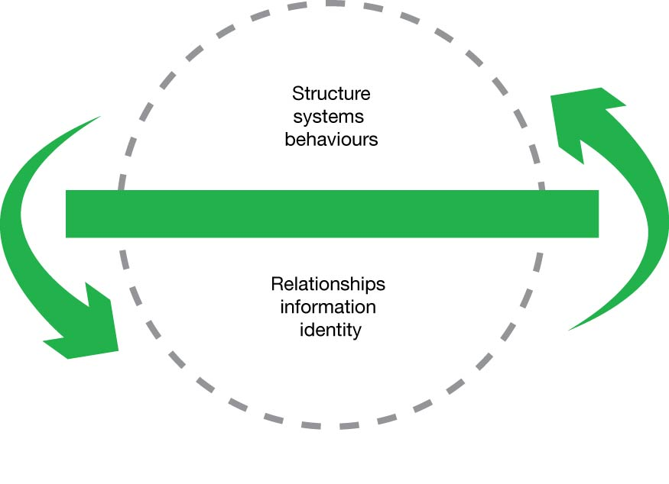
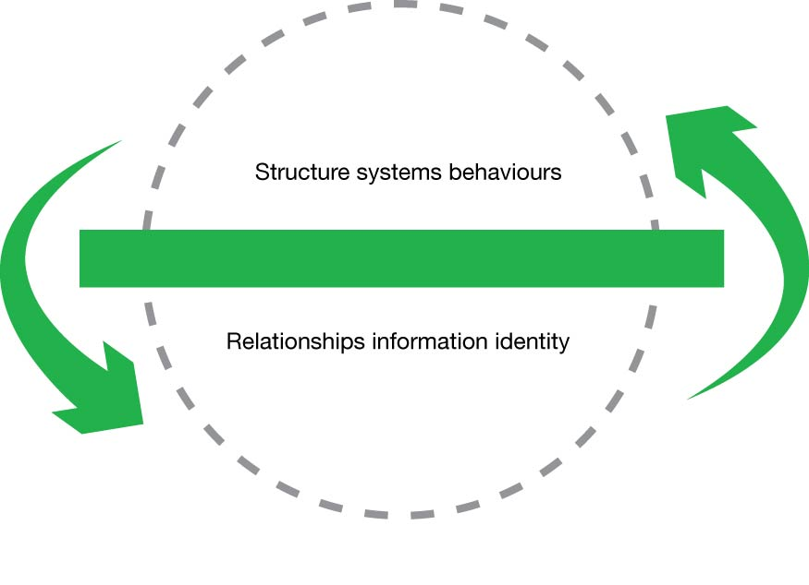
The Ecosystem : ‘Green Line’ Model (Wheatley & Rogers 1996 )

Slide 4
The collaborative process
The multi-stakeholder process is usually not just one event:
it is a series of dialogues, workshops, seminars over time; used to build networks with shared knowledge and understanding between groups; with a shared interest in collaboration to achieve a positive outcomes.
They are using different entry points to the dialogue and are based in different value and culture sets.

Slide 5
Actions in complex systems
3 key elements which differ based on level of system complexity (www.complexability.com.au)
 | Obvious | Complicated | Complex | Chaotic
Approach needed | Fact based Sense-categorise-respond | Fact based Sense-analyse -respond | Emergent identification of patterns Probe-sense -respond | Immediate action to stabilise Act-sense -respond
Type of work | Task lists, procedures | Coordination of multiple tasks and experts | Co-design Co-creation Emergent insights | Crisis management Opportunity to innovate
Partnering and engagement | Outsource, networking | Transactional coordination cooperation | Integrated or transformational | Command & control to stabilise; innovate to shift

Slide 6
There is a lot of noise in this space…
Public management is slowly waking up to the fact that this is a powerful way to build successful shared outcomes, which means:
There is a willingness to invite other sectors or disciplines into the space
There is a wide range of advice on processes and tools to assist in making connections
There are many approaches being touted as the best
Most can be successful if well facilitated.

Slide 7
The question
What is the role of the practitioner in the process of collaboration and co-production?
Participant, facilitator, observer?
When should they be brought in to the process?
What capabilities do they need? at what level?
What is the shared understanding of the role of the facilitator?

Slide 8
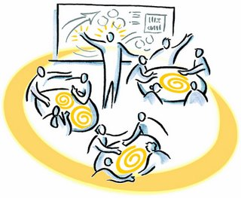
Challenge Question
Have you ever been on the receiving end of a poor facilitation experience?

Slide 9
What needs to be clear from the outset
Context – the environment and forces at play
Purpose – the common problem definition
Critical Issues – the what if..? and how to..?
Role clarity – who is doing what?
Design – who is designing the process
Decision maker
Accountability
Clarify all this BEFORE we bring everyone together!

Slide 10
What is a facilitator?
Kaner et al (2016) describe the facilitator as someone who:
Enables groups & organisations to work more effectively
Is a ‘content-neutral’ party
Does not take sides or expresses a position
Advocates fairly, openly and inclusively
Uses inquiry methods
Is a guide for learning or dialogue, to assist a group to think deeply about assumptions, beliefs and values

Slide 11
Why you can’t facilitate from within your own organisation
Imagine you are a senior manager acting as facilitator. You are faced with the dilemma of taking yourself (with all your knowledge, expertise, wisdom and capability) out of the process.
Most find this difficult to do and become enmeshed in the discussion, allowing personal bias to filter through.
This may create blind-spots, polarise the participants, or create an adversarial situation with the group coalescing against the facilitator.

Slide 12
Facilitator capabilities
Presence, energy
Co-designs the process – bring them in early!
Creates and holds the safe, shared space
Facilitates rather than controls
Builds relationships and group bonds
Engenders trust and respect with all parties
Is expert in recognising and managing group dynamics, tensions, conflict
Manages the energy of the group as whole
Ensures all voices are heard
Intuitive and empathetic
Acquires context knowledge rapidly

Slide 13
Also needs to know how to be..
a Process disturber
a Provocateur
An equal in the room
Courageous
Spanner in the works
Bolting it all together

Slide 14
Invisible?
The facilitator is there to facilitate, not to:
be the centre of attention
hold the floor
control
share their personal views and biases
to be right
inflexibly hold to agendas
When all is done, the group owns the outcomes.

Slide 15
Invaluable?
An expert facilitator adds value at every step of the way through:
Being authentic
Bringing expertise not present in the room
Genuine interest in the issues and the individuals
Ability to ‘rescue’ when things are going off track badly
Manages time - but not to a rigid program
Agile process responses, models and tools
Rapid acquisition and understanding of context, purpose
Exceptional management of group dynamics
Therefore is critical to success.

