Slide 1
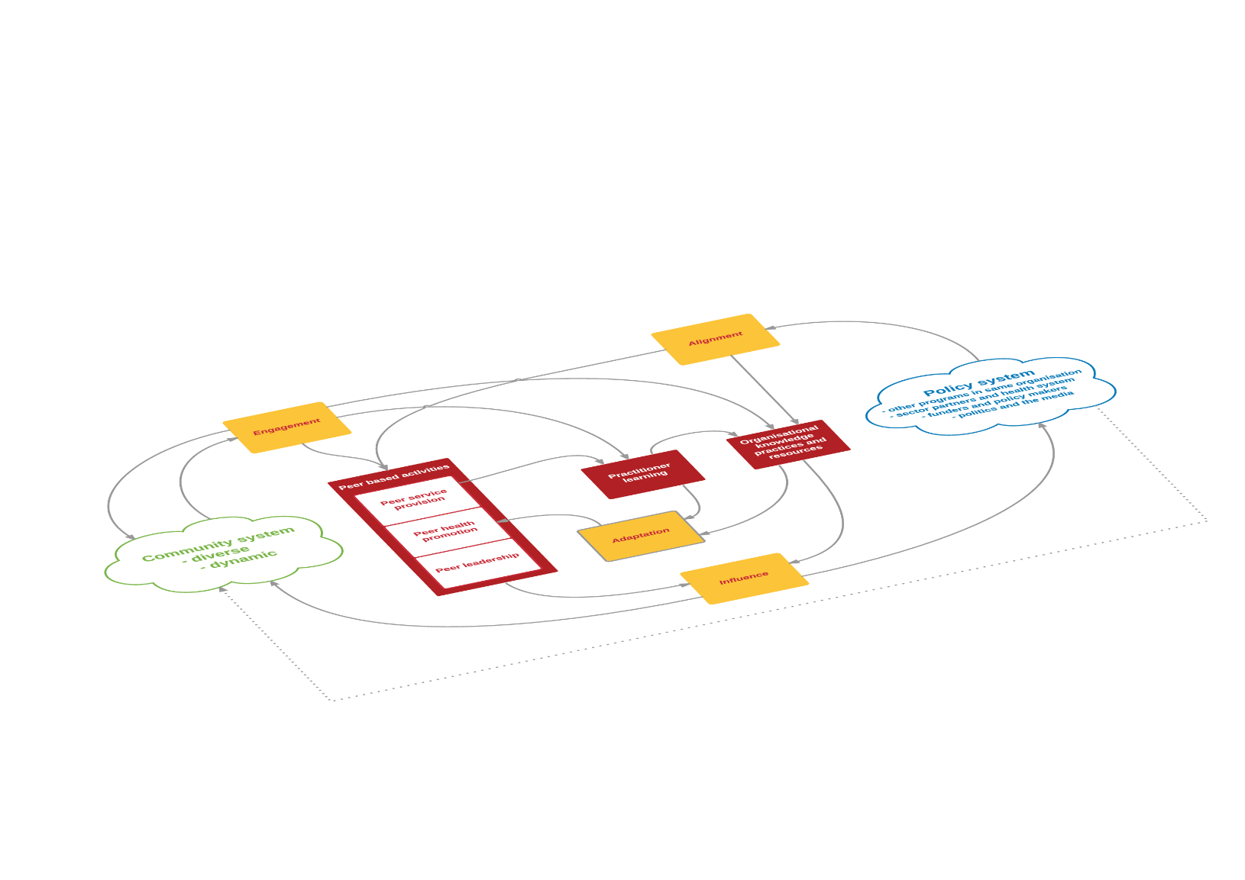
W3 Project
Sex, Drugs and Politics
Enhancing the influence of peer-led health promotion in community and policy systems
Graham Brown
Australian Research Centre in Sex, Health and Society,
La Trobe University
www.w3project.org.au
Melbourne, Australia
latrobe.edu.au/arcshs

Slide 2
Peer Based Programs in HIV/HCV
Underpin the partnership approach in HIV / HCV
Programs are inextricably linked to constant changes in their community and policy systems
Complex relationship between investment and outcomes – difficult to demonstrate
What makes one peer program a more authentic and effective investment than another within these complex environments?
Notes:
Australia’s response to HIV has often celebrated the partnership of affected community, clinicians, research and government.
The key role of affected communities has been underpinned by peer- based health promotion and leadership among gay men, people who use drugs, sex workers, and people living with HIV.
These programs have needed to navigate and adapt to constantly changing political and stigmatising contexts around sex, sexuality and drug use.
At its core, peer-based health promotion is all about interactions between the program and the communities and political climate within which it functions.
Measuring the quality and impact of specific peer-led programs and their leadership role is challenging. ²⁴⁻²⁸
Most evaluations look at the quality and impact of programs and fidelity to a pre-defined program in isolation from their context, and struggle with the complexity of their interactions with the rapidly changing community and socio-political contexts in which they are implemented.²²
However community and peer-led health promotion is all about interactions between the program and the communities it works with and the policy environment within which it operates and collaborates.
What often results is rhetoric about community mobilisation and peer-led responses, and the importance of combining behavioural, biomedical and structural responses, but resulting in community and peer-led programs funded, evaluated and managed as generic and predetermined information dissemination or service provision.
But what makes one community led program a more authentic and effective investment than another.
The W3 project wanted to really shift our capacity to understand and demonstrate their role and influence beyond what they may be funded to do

Slide 3
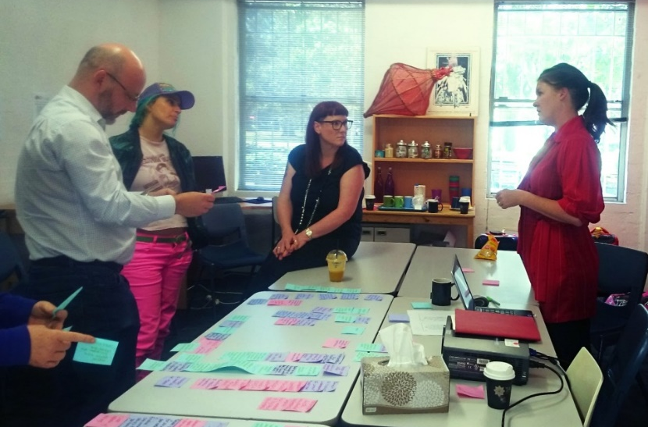
W3 approach
Draw together the mental models of experienced practitioners in peer led programs
Develop system maps of interventions embedded in complex community and policy systems.
Identify key functions and how they strategically relate to each other
Develop and prioritise indicators
Notes:
Over a two year period we conducted a series of 18 workshops ranging from one to two days each with the 10 programs. Some workshops were with single organisations and some with multiple organisations. Over 90 people were involved across the workshops.
The aim was to bring together the practice based understandings and mental models about peer-led programs from outreach staff, community development, management and board members – where everyone has part of the picture but rarely brought together.
What systems thinking brought to the table was an understanding that for peer led programs - the way communities respond, enhance, adapt, resist or ignore interventions are part of the program and something to be leveraged, it provides critical insights to the reality of communities, not something to be resisted or treated as a confounder.
Systems helps us to consider the relationship between all the parts of the picture, and – assuming that the ground will keep moving - look for the best leverage points and synergies as the system and the programs continue to adapt and evolve.
So our work with the 10 programs involved drawing and articulating very complex system maps – like a map of an ecological system - describing what happens in the reality of these programs and their relationships with all the components of their community and policy system.
I am happy to describe this process in more detail if there are questions.

Slide 4
The four key functions that need to be happening for a program to be effective and sustainable in a constantly changing environment.
Function | Definition
Engagement | How the program maintains up to date mental models of the diversity and dynamism of needs, experiences and identities in its target communities.
Alignment | How the program picks up signals about what’s happening in its policy / sector environment and uses them to better understand how it works.
Adaptation | How the program changes its approach based on mental models that are refined according to new insights from engagement and alignment.
Influence | Community | How the program uses the community’s existing ways of doing things to promote new ways of doing things.
 | Policy | How the program achieves or mobilises influence on processes and outcomes within its policy environment.
Notes:
We stepped back and identified four key functions that were present across the many program specific system maps we had developed.
Engagement
How the program maintains up to date mental models of the diversity and dynamism of needs, experiences and identities in its target communities.
Alignment
How the program picks up signals about what’s happening in its policy / sector environment and uses them to better understand how it works.
Learning and Adaptation
How the program changes its approach based on mental models that are refined according to new insights from engagement and alignment.
Influence – community
How the program uses the community’s existing ways of doing things to promote new ways of doing things.
Influence – Policy
How the program achieves or mobilises influence on processes and outcomes within its policy environment.

Slide 5
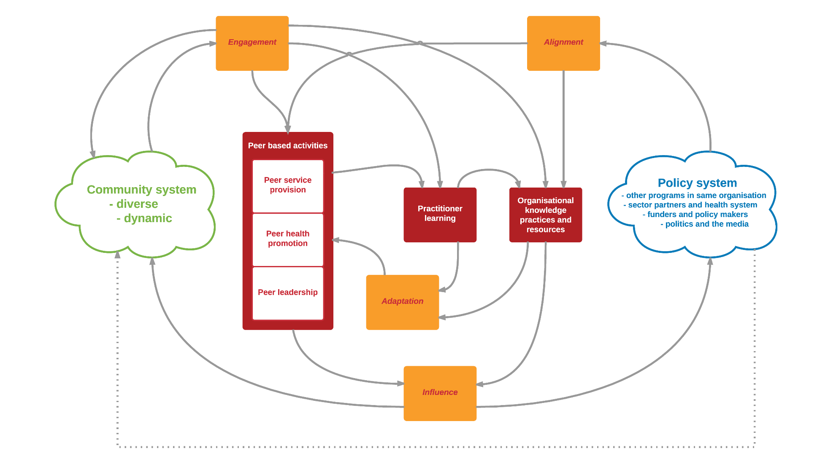
Notes:
The most important aspect of the framework is how these four functions interact and influence each other – if one is not functioning well it impacts on the whole system and undermines all the others.
There are folders with details of the framework available or on our website.
Clouds - separate but overlapping complex adaptive systems.
-Peer led - mediating role between and within
Peer activities and peer skill
Peer service provision –peer led needle and syringe program
Peer health promotion –, community development, targeted social marketing, and so on
Peer leadership - leadership roles in their community, their sector, or participating in policy reform
The more a peer-led program was able to demonstrate authentic understanding of their community (engagement), and effective use of peer-skill in interpreting research and service data from the sector (alignment), and then package this in a way that is useful to the sector (adaptation), the more confidence the sector would have in the accuracy and usefulness of the advice (influence).
However, if the policy sector was unwilling to value the role and insights from peer leadership, regardless of quality (influence), then this would limit the capacity of the sector, including the peer-led programs, to adapt and respond (alignment).
The less the policy system enabled the peer led program to adapt (alignment) the less influential will be the role of the peer program in their community.
The less influential their role, the less engagement with their community and so the fewer real time insights (such as unexpected adaptations to biomedical prevention or consequences of policy changes) to guide the broader policy sector.
Relates directly to the Evelyns presentation and the Howlett (2015) paper
______________________
Engagement and Participation - Example –changes in drug use through their services, their outreach and their own personal networks – all three gave a triangulated real time engagement…….Real-time insights are critical to a peer leadership being relevant and persuasive.
Learning and Adaptation
- An unchanging program is seen as a red flag
Rapid change in drug use environment – the increase in steroid use in Western Australia was related to the resources boom –
Influence - community
It is about what influence a peer based program has by participating within the community, by being an active structural part of that community.
Influence – Policy and sector
WASUA Example – recognising early the shifts in drug use patterns or how policy barriers may play out differently for this group
WASUA - rapid consultation through its client base and networks and share that effectively with local services and partners.
increased their reputation in the sector – and so supported faster responses in for future issues (links to Alignment)
Alignment
WASUA example (example of political vulnerability??)
Insights from engagement and peer-skill can also help the peer programs interpret changes in surveillance outcomes and place social research findings in a practical context..
___________________________________
The focus is on the flows of influence through the functions. For example-
Are the programs’ understanding of the community accurate and timely enough to adapt and refine their action? (Engagement-Adaptation - influence)
Is the program maximising synergies with the broader sector system to enhance their influence in their community? (Influence- Alignment-Influence)
Is the program maintaining its influence and participation in community to sustain engagement (influence-engagement -adaptation)

Slide 6
Feasibility trials
Framework➔ Indicators ➔ Tools
Notes:
The functions are like headings for more specific and tailored indicators, and for the last year we have been developing indicators across the functions and relationships
The W3 Framework assists peer leaders to understand the relationship between the elements of their system.
From on the ground peer outreach through to broader policy reforms and back again.
It provides a framework to draw together the formal and informal evaluation data, programmatic insights, and community anecdotes in a way that can be more meaningful, useful and persuasive ….(we hope).
Peer leadership needs to not only demonstrate authenticity to advocate on behalf of their community– but this authenticity needs to be recognised and supported by the sector, and the influence timed to when the opportunity / window emerges
- its about the enabling environment being called to account
Relates directly to the Evelyns presentation and the Howlett (2015) paper

Slide 7
How can we meaningfully enhance our investment in community and peer led responses (to HIV & HCV)
Focus on the four key system level functions that are required for peer-led programs to:
demonstrate the authenticity and timeliness of their peer and community insights;
adapt to changing contexts and policy priorities in tandem with their communities.
Persuade, influence and add value to community and sector/policy systems to improve health;
If funders, policy-makers and researchers are not building the strength of, and gaining strategic benefit from, peer-leadership, then the HIV response may be undermining rather than maximising our capacity to reach the HIV targets with our communities.
Notes:
Focus on the four key system level functions that are required for peer-led programs to:
demonstrate the authenticity and timeliness of their peer and community insights;
adapt to changing contexts and policy priorities in tandem with their communities.
Persuade, influence and add value to community and sector/policy systems to improve health;
If funders, policy-makers and researchers are not building the strength of, and gaining strategic benefit from, peer-leadership, then the HIV response may be undermining rather than maximising our capacity to reach the HIV targets with our communities.

Slide 8
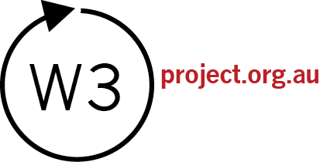
What Works & Why (W3) is a project of the Australian Research Centre in Sex, Health and Society at La Trobe University.
Visit us on the web at www.w3project.org.au
Authored by Dr Graham Brown and Daniel Reeders
Funded by the Commonwealth Department of Health
Copyright © 2015 La Trobe University

Slide 9
Spare slides if questions/ discussion

Slide 10
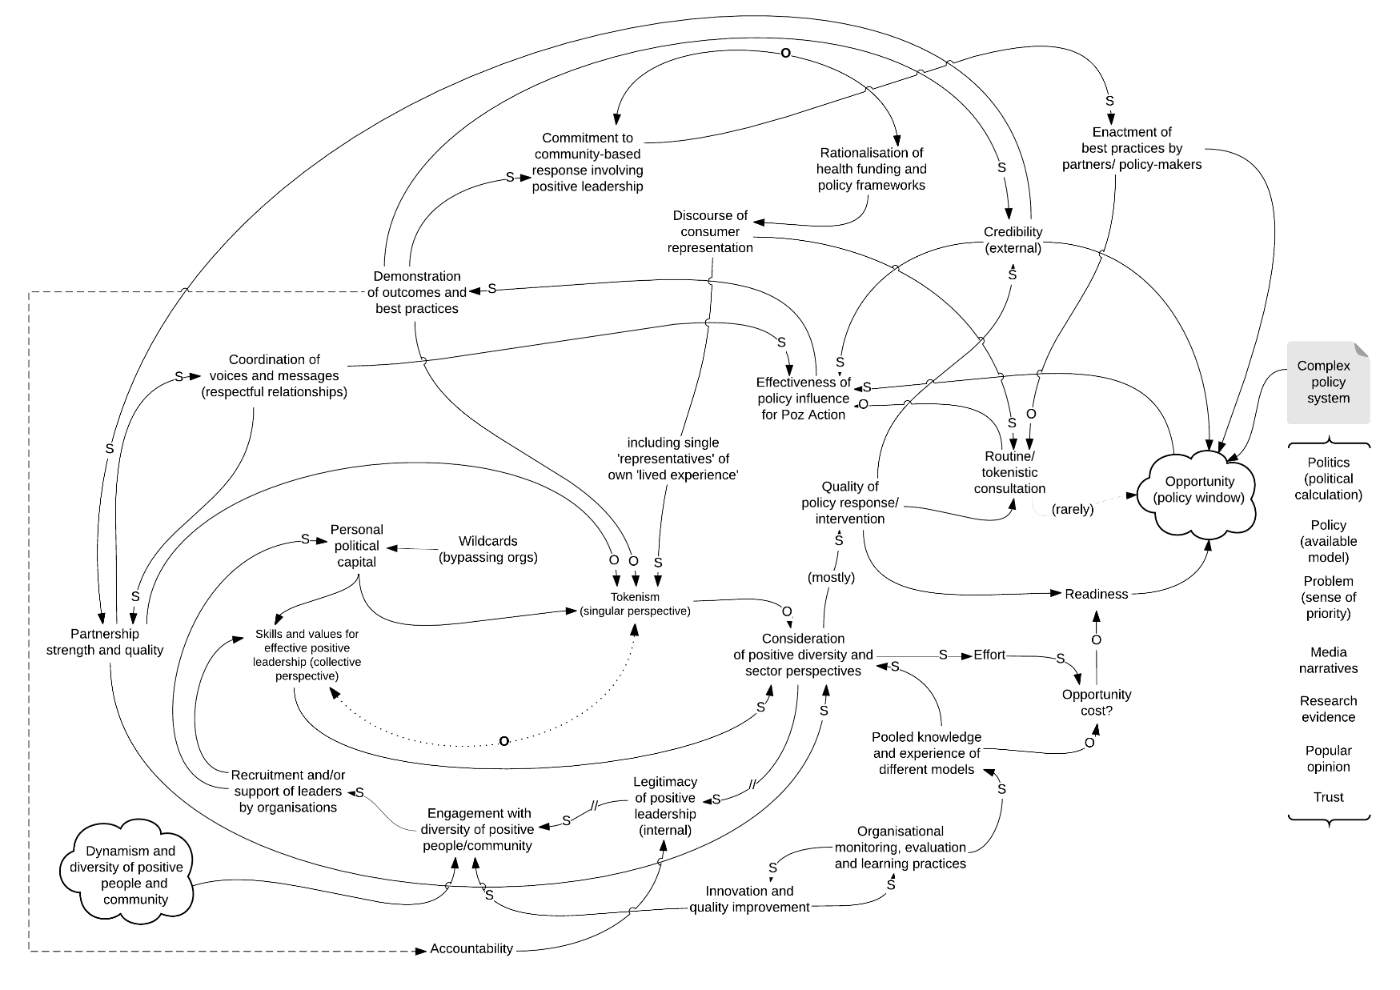
Alignment
Influence
Engagement
Adaptation

Slide 11
The four key functions are things that need to be happening for a program to be effective and sustainable in a constantly changing environment.
Function | Example Indicators (usually 4-5 for each function)
Engagement | Insights from on the ground peer programs update and strengthen the understanding of how PrEP is being used in the community Community members recognise the program as a participant within its networks and cultures and feel a sense of ownership around its work
Alignment | Other programs and sector stakeholders adapt their approach to support the effectiveness of the program. The organisation communicates with sector partners to improve their understanding of the program’s perspective on emerging issues. The program actively seeks out and uses knowledge from partners and stakeholders with different perspectives on emerging issues within the sector

Slide 12
The four key functions are things that need to be happening for a program to be effective and sustainable in a constantly changing environment.
Function | Example Indicators (usually 4-5 for each function)
Adaptation | The program integrates peer insights with knowledge acquired from research, and signals from the policy system Organisational leadership support continual practitioner learning and peer insights as an organisational and strategic asset
Influence | Community | Materials produced by health promotion undergo circulation, adaptation and incorporation by members of target networks and cultures. Reach and recall of health promotion products, images or messages among members of the targeted networks and cultures
 | Policy | Policy, media and funding environment supports (or does not impede) innovative and culturally relevant approaches to expanding meanings of safe sex The broader sector and policy system includes and values the peer approach and insights it generates

